Slide 1



OUR CLIENT’S RESULTS
&
CASE STUDIES

Slide 2
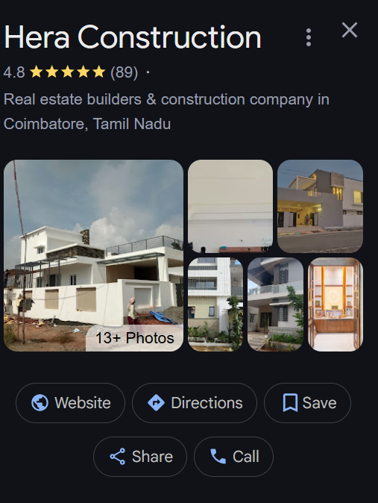

RESULT #1
HERA CONSTRUCTIONS - COIMBATORE
Issues they are faced
  Getting leads only by word of mouth
  Losing clients while they are busy at their work
  poor online prescence in their city
  getting bad reviews
  wasting money on social media and other agencies..
Within 3 months ”HERA CONSTRUCTIONS” got 53 reviews and got 72 leads from their website.

Slide 3

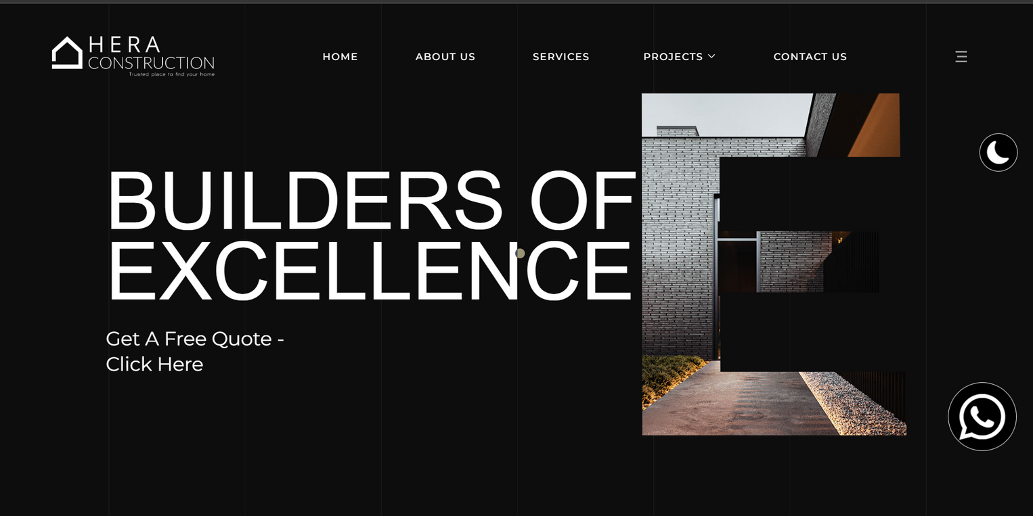
We made a system & smart website that is suitable and helps them rank higher in google and protect their reputation from getting bad reviews. the website has an ai that automatiocally send leads and good quality prospects to them 24/7.

Slide 4
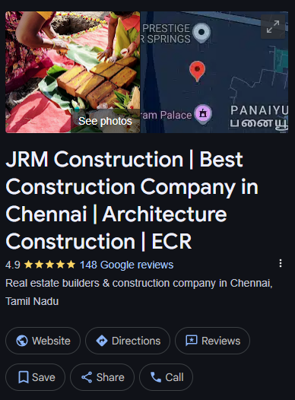
RESULT #2
JRM CONSTRUCTIONS - CHENNAI
Issues they are faced
  Getting leads only in word of mouth & reffral’s
  poor online prescence in their city
  getting bad reviews and not getting many reviews
  They dont have time to manage their website.
Within 4 months ”JRM Constructions” got 82 reviews and got 59 leads from their website.

Slide 5
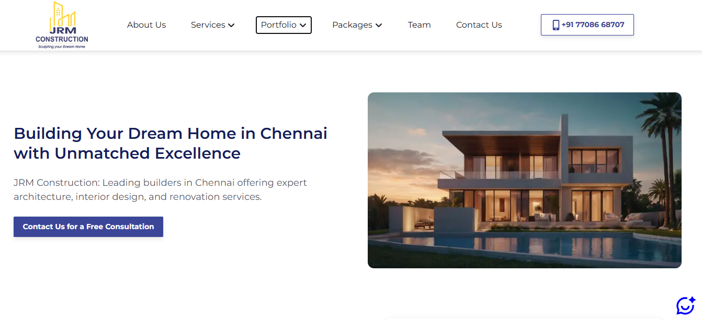
We made a system & smart website for “JRM Constructions” that made them to rank higher in google and protect their reputation from getting bad reviews. the website has an ai in-built inside that automatiocally send leads and good quality prospects to them & we managing their system 24/7.

Slide 6
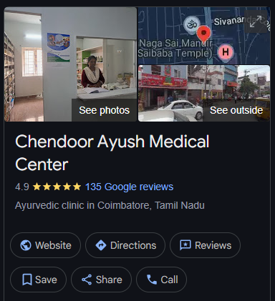
RESULT #3
CHENDOOR AYUSH MEDICAL CENTER - COIMBATORE
Issues they are faced
  No online presence and needed a booking system for thier patients to book appointment’s.
  no good reviews and no infuence in their city
  getting bad reviews
  lost their many money on socail media agencies
Within 6 months ”Chendoor Ayush Medical Center” got 76 reviews and got 142 appointment’s from their website.

Slide 7
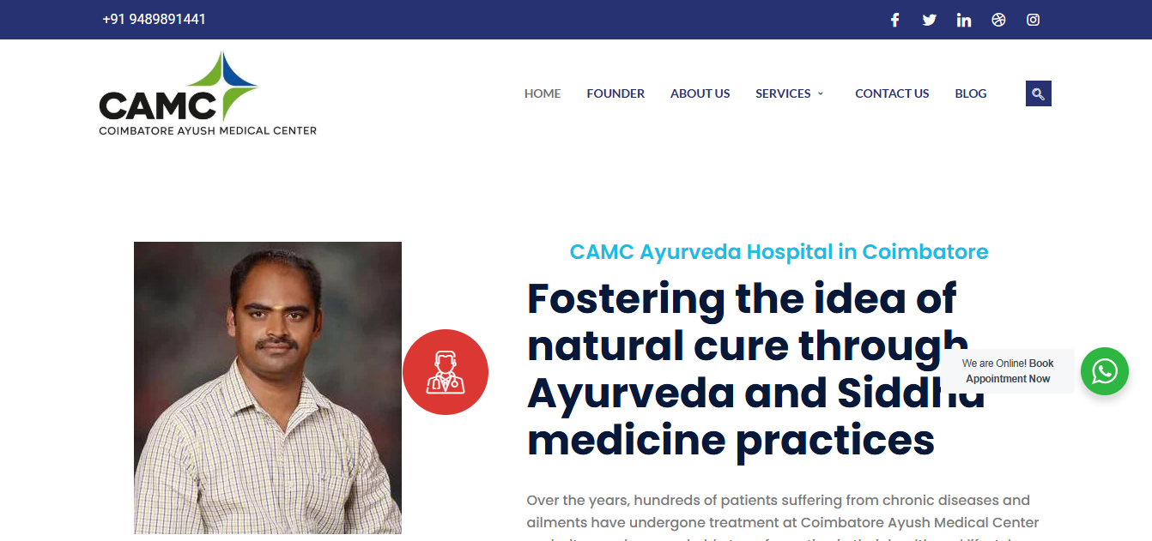
We built a simple good looking website with thier porfolio and what they do and what services they provide. and we add a bot that book them appointment to their calender in their clinic, and we added a reputation management system that generates them only good reviews and make them rank higher in their city on google.

Slide 8
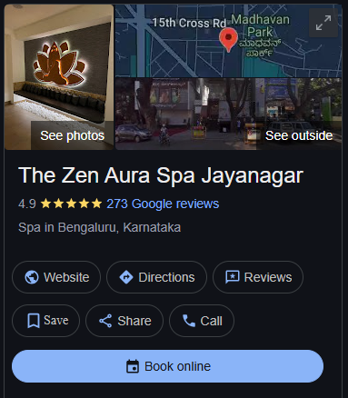
RESULT #4
THE ZEN AURA SPA JAYANAGAR - BANGLORE
Issues they are faced
  Not recoganized in their city
  No good buisness profile and online prescence
  they keep getting bad reviews
  no time to managing online system’s
  no website or booking systems
Within 190 day’s ”The Zen Aura Spa Jayanagar” got 169 reviews and got 293 appointment’s from their booking system.

Slide 9
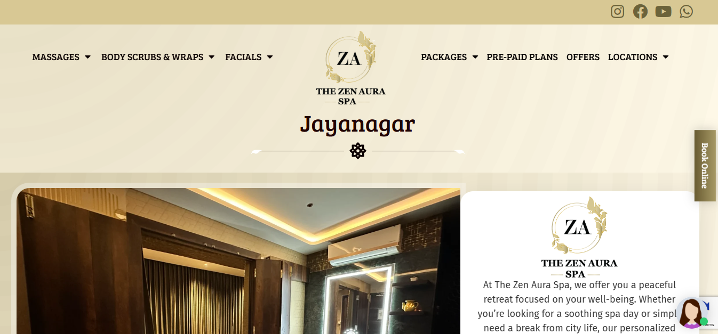
We built a simple good looking website with thier service, pricing and their detials about their buisness. and we add an ai that books appointment and collects the contact detials for CRM follow ups, and we add a reputation management to their buisness that keeps adding good reviews only..!, that made them rank higher in their city and bringing them more calls and appointment‘s everyday..

Slide 10
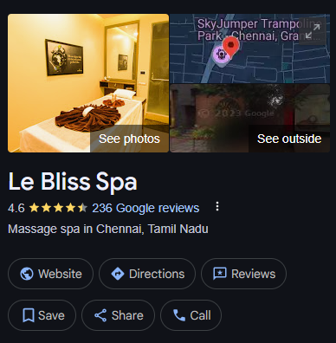
RESULT #5
LE BLISS SPA - CHENNAI
Issues they are faced
  no website or no online booking systems
  Not recoganized in their city
  No good buisness profile and online prescence
  they keep getting bad reviews
  no time to managing online system’s
Within 241 day’s ”Le Bliss Spa” got 187 reviews and got 147 appointment’s from their online booking system.

Slide 11
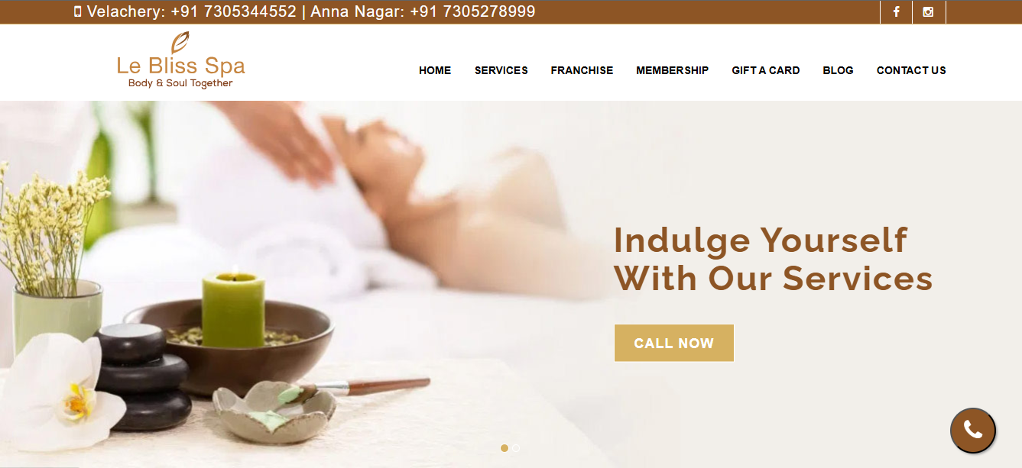
We built a simple good looking website with thier service, pricing and their detials about their buisness. and we add an ai that books appointment and collects the contact detials for CRM follow ups, and we add a reputation management to their buisness that keeps adding good reviews only..!, that made them rank higher in their city and bringing them more calls and appointment‘s everyday..

Slide 12
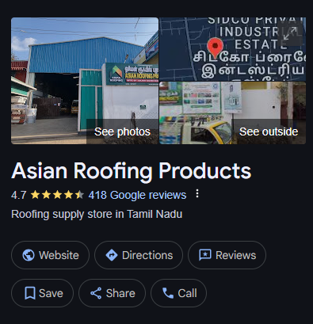
RESULT #6
ASIAN ROOFING PRODUCTS - COIMBATORE
Issues they are faced
  no website or no online booking systems
  Not recoganized in their city
  they didnt have optimized buisness profile
  they keep getting bad reviews
  no time to managing online system’s / website
In 8 month’s ”Asian Roofing Products” got 237 reviews from their reputation management system. ranked top 2 in their city..!

Slide 13
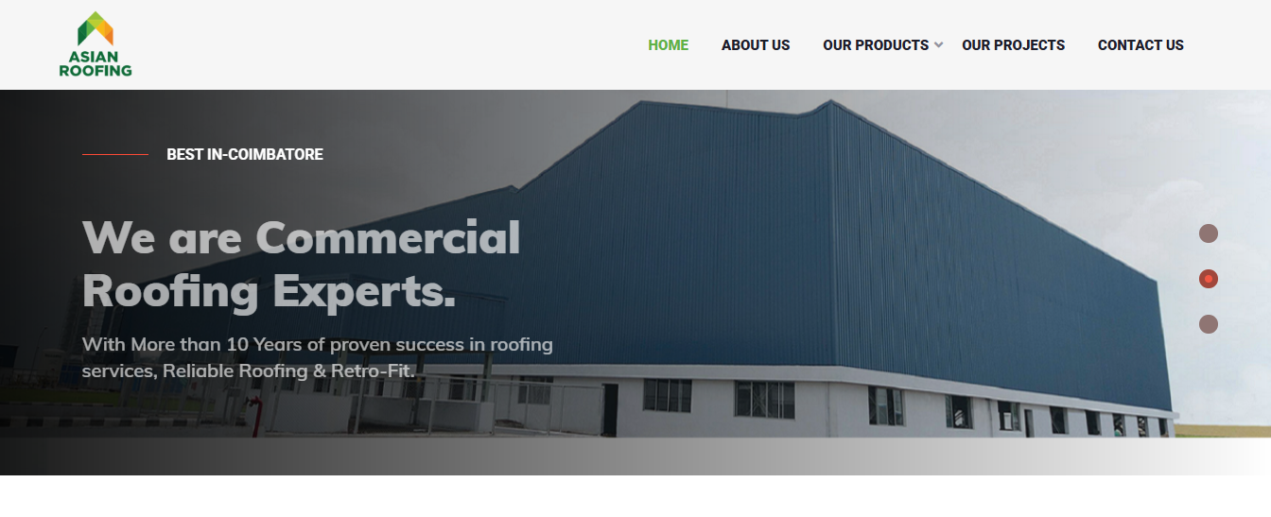
We built a simple elegant website that contains their detials about thier service and their buisness, and we intergrated reputation management system to stack more good reviews and made them ranked up to top 3 in their city within 8 months.

Slide 14
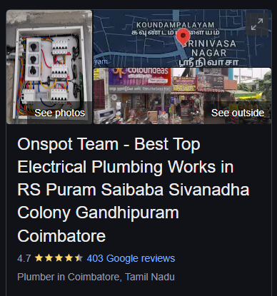
RESULT #7
ONSPOT TEAM ELECTRICAL/PLUMBING - COIMBATORE
Issues they are faced
  Getting leads only by word of mouth
  Losing clients while they are busy at their work
  poor online prescence in their city
  getting bad reviews
  wasting money on social media and other agencies..
In 8 month’s ”Asian Roofing Products” got 237 reviews from their reputation management system. ranked top 2 in their city..!

Slide 15
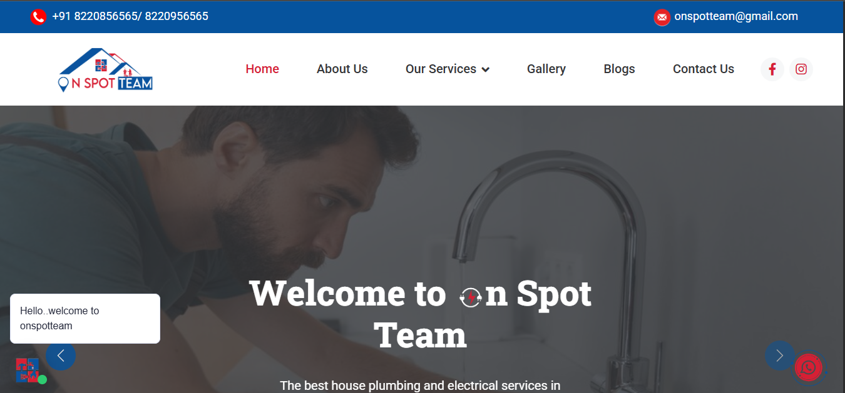
We made a system & smart website for “Onspot Team Electrical/Plumbing” that made them to rank higher in google and protect their reputation from getting bad reviews. the website has an ai in-built inside that automatiocally send leads and good quality prospects to them & we managing their system 24/7. and made them to get more call & bookings..!

Slide 16
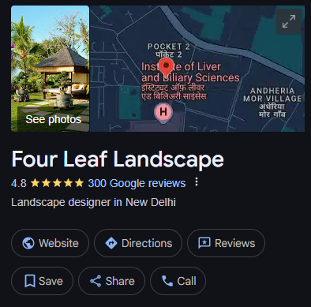
RESULT #8
FOUR LEAF LANDSCAPE - NEW DELHI
Issues they are faced
  Getting leads only in word of mouth & reffral’s
  poor online prescence in their city
  getting bad reviews and not getting many reviews
  They dont have time to manage their website.
In 8 month’s ”Asian Roofing Products” got 237 reviews from their reputation management system. ranked top 2 in their city..!

Slide 17
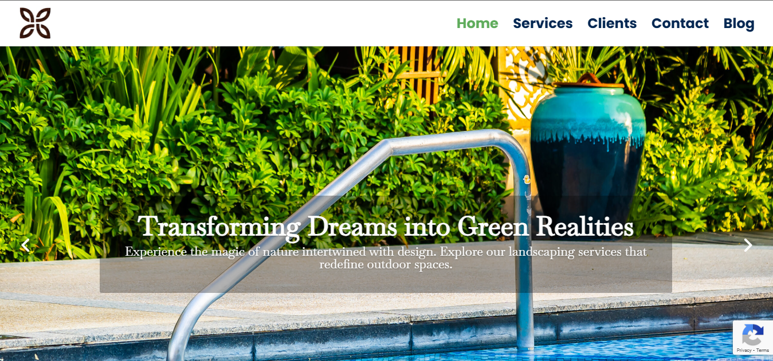
We built a simple good looking website with thier service, pricing and their detials about their buisness. and we add an ai that books appointment and collects the contact detials for CRM follow ups, and we add a reputation management to their buisness that keeps adding good reviews only..!, that made them rank higher in their city and bringing them more calls and appointment‘s everyday..

Slide 18

ABOUT US
We make local buisness owner to make 2x or 4x their income with our skills and systems.
we saw how much local buisness are lossing their money on their table in front of them.
and we fixed find and made a solution for it.
we belive in giving value first..!
we work on trust and hardwork..

Slide 19

CONTACT US
gamil : vz.sivanesh@gamil.com
+91 9025966416

